Slide 1
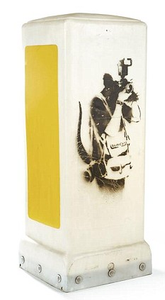
Art, finance & law
The importance of due diligence in relation to art used as security for a loan
Attribution & Authenticity
Ownership
Provenance
Condition
Copyright
Description of the Work
Valuation
Compliance with Custom Formalities
Tax Liability
Banksy’s “Rat on a Bollard”

